Slide 1
Classification
Alejandro Ordonez
Assistant Professor - Department of Bioscience
Section for Ecoinformatics & Biodiversity
Center for Biodiversity Dynamics in a Changing World (BIOCHANGE)

Slide 2
Classification What we will talk about today
What is classification – Patterns in a collection of objects.
Distance Matrices – Measuring (d)similarity.
Classification as a multivariate approach
Hierarchical clustering – The tree based approach.
Non-Hierarchical clustering – A single partition.

Slide 3
Any questions?
Ready to start?

Slide 4
The problem at hand
Organism attributes
Biological/ecological datasets are multidimensional
What is multidimensional? → multiple descriptors are recorded from a number of objects (i.e., replicate sampling or experimental units)
Organisms: morphological or physiological measurements
Ecological sampling units: the variables might be physicochemical measurements or species abundances
Ecological sampling units

Slide 5
Regression vs. Multivariate
The goal of a regression:
Test for a relation between descriptors and response variables among objects
Test a H_{o}: is β_{i}=0
The goal of classification:
Visualise the association between objects
Clustering: Group the observations.
Ordination: Reposition the observations in less dimensions
In a strict sense, classification analyses are not statistical test or models
Because no Hypothesis is tested.

Slide 6
Classification – The Goal
The objective
Recognize discontinuous subsets in an environment that is sometimes discrete (as in taxonomy), but most often perceived as continuous in ecology.
How?
Using the association between elements in a collection of objects, these are partition based on a set of criteria/rules
Hard partition: each observation belongs to one and only one subset.
Fuzzy partitions: the membership of each observation is continuous.

Slide 7
Classification Why go to all the trouble?
Classification is an way to simplify the description of the data by means of groups
What classification does?
Group together a number of objects based on their attributes or variables
Produces groups of objects where each object within a group is more similar to other objects in that group than to objects in other groups.
Classification is a traditional tool of GIS analysis (land cover classes), and several informal subjective systems

Slide 8
Classification - Classes
Hierarchic methods have several nested levels of classification.
Agglomerative methods combine sampling units to classes and classes to classes.
Divisive methods split data and then split the splits.
Non-hierarchic methods perform classification at one level.
K-means: Often optimised at one level iteratively.
Probabilistic and fuzzy models: not a sharp classification, but a probability of belong to a class.

Slide 9
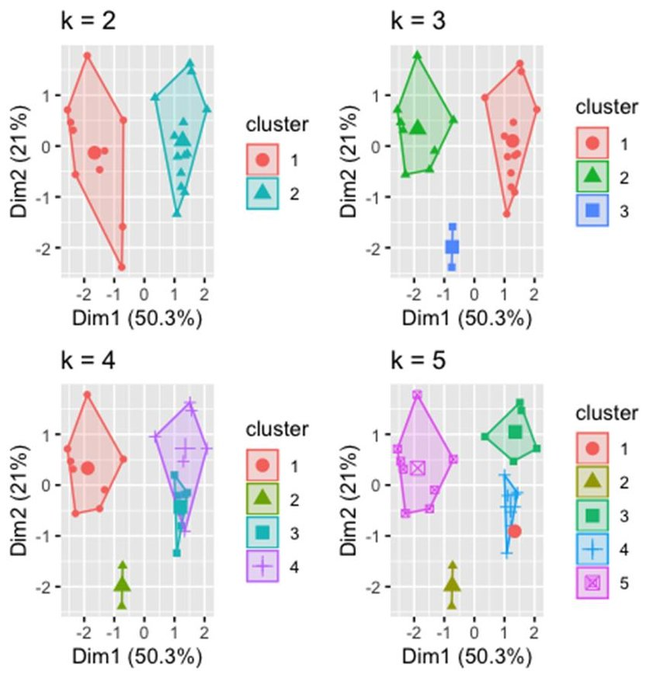
Classification - Classes
Hierarchic
Non-hierarchic

Slide 10
Classification – Algorithms
Sequential or simultaneous.
Grouping by repetition a procedure OR a solution in reached in a single step.
Agglomerative or divisive.
Successively grouping into larger groups OR Successively dividing it into subgroups.
Monothetic versus polythetic .
Single descriptor at each grouping step OR all descriptors are used (via association matrix).
Hierarchical versus non-hierarchical .
Subgroups are nested in higher order groups OR single partition without any hierarchy.
Probabilistic versus non-probabilistic.
Within-group association matrices have OR not given probability of being homogeneous.
Unconstrained or constrained methods.
Based on a single data set OR two data set (clustered elements + explanatory variables).

Slide 11
Classification – Algorithms
Sequential or simultaneous.
Grouping by repetition a procedure OR a solution in reached in a single step.
Agglomerative or divisive.
Successively grouping into larger groups OR Successively dividing it into subgroups.
Monothetic versus polythetic .
Single descriptor at each grouping step OR all descriptors are used (via association matrix).
Hierarchical versus non-hierarchical .
Subgroups are nested in higher order groups OR single partition without any hierarchy.
Probabilistic versus non-probabilistic.
Within-group association matrices have OR not given probability of being homogeneous.
Unconstrained or constrained methods.
Based on a single data set OR two data set (clustered elements + explanatory variables).
Most methods presented below are sequential, agglomerative and hierarchical

Slide 12
So far so good?
Any questions?
Ready to move on?

Slide 13
Classification It is all about distances

Slide 14
Classification Attributes of distance measurements
Semimetric
Non-metric
Axioms
Metric
Coincidence: The minimum value is zero when two items are identical | + | + | +/–
Non-negativity: When two items differ, the distance is positive (negative distances not allowed) | + | + | +/–
Symmetry: the distance from object A to object B equals the distance from B to A | + | + | +/–
Triangle inequality: with three objects, the distance between any two of these cannot be larger than the sum of the two other distances | + | – | –
D(a, a) = 0
D(a, b) > 0
D(a, b) = D(b,a)
b
a
c
D(a,c) <= D(a,b)+D(b,c)

Slide 15
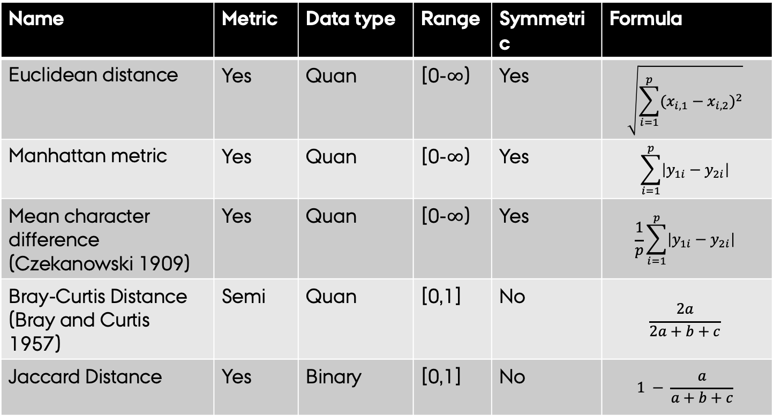
Classification Kinds of dissimilarity measurements
Name | Metric | Data type | Range | Symmetric | Formula
Euclidean distance | Yes | Quan | [0-$∞$) | Yes | $$\sqrt{\sum_{i=1}^{p}{{(x_{i,1}−x_{i,2})}^{2}}}$$
Manhattan metric | Yes | Quan | [0-$∞$) | Yes | $$\sum_{i=1}^{p}{\left|y_{1i}−y_{2i}\right|}$$
Mean character difference (Czekanowski 1909) | Yes | Quan | [0-$∞$) | Yes | $$\frac{1}{p}\sum_{i=1}^{p}{\left|y_{1i}−y_{2i}\right|}$$
Bray-Curtis Distance (Bray and Curtis 1957) | Semi | Quan | [0,1] | No | $$\frac{2a}{2a+b+c}$$
Jaccard Distance | Yes | Binary | [0,1] | No | $$1 − \frac{a}{a+b+c}$$
Environmental data
Species data

Slide 16
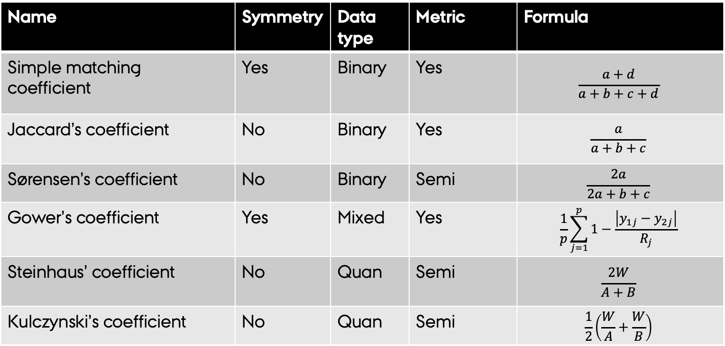
Classification Kinds of similarity measurements
Name | Symmetry | Data type | Metric | Formula
Simple matching coefficient | Yes | Binary | Yes | $$\frac{a+d}{a+b+c+d}$$
Jaccard’s coefficient | No | Binary | Yes | $$\frac{a}{a+b+c}$$
Sørensen’s coefficient | No | Binary | Semi | $$\frac{2a}{2a+b+c}$$
Gower’s coefficient | Yes | Mixed | Yes | $$\frac{1}{p}\sum_{j=1}^{p}{1−\frac{\left|y_{1j}−y_{2j}\right|}{R_{j}}}$$
Steinhaus’ coefficient | No | Quan | Semi | $$\frac{2W}{A+B}$$
Kulczynski’s coefficient | No | Quan | Semi | $$\frac{1}{2}\left(\frac{W}{A}+\frac{W}{B}\right)$$
Species data
Environmental data

Slide 17
Measuring distances in R
Most of the ecological relevant distances are incorporated in the vegdist method of the vegan package
Jaccard and Sørensen coefficients are also available through betadiver methods also in the vegan package
The code for R
require(vegan)
data(varespec) # Vegetation and environment in lichen pastures data
vegdist(varespec)
vegdist(varespec, method="bray") # However the default distance is Bray-Curtis
vegdist(decostand(varespec, "norm"), method="euclidean")) # Euclidean Distance. The decostand function is used for transforming community matrices
vegdist(decostand(varespec, "range"), method="gower") # Gower’s Distance

Slide 18
So far so good?
Any questions?
Ready to move on?

Slide 19
Hierarchical Clustering
Also called Hierarchical cluster analysis or HCA is an unsupervised clustering algorithm
The endpoint is a set of nested clusters,
Each cluster is distinct from each other cluster.
Objects within each cluster are broadly similar to each other.
Cluster-1
Cluster-4
Cluster-2
Cluster-3

Slide 20
Hierarchical Clustering
The input is a distance matrix that defines the “similarity” between objects.
So the first decision to make is which distance to use.
The main output of Hierarchical Clustering is a dendrogram.
The appearance of it dependence on the Linkage Criteria → how are clusters put together

Slide 21
Hierarchical Clustering – The Steps
Start with combining/splitting two most similar sampling units
Proceed with combining two next similar or cluster to cluster
Continue until all objects are combined within the tree.
These trees are build using the hclust()f function on a distance matric crated using dist() or vegdist().

Slide 22
Hierarchical Clustering How to cluster?
Single linkage
the most different points.
[Furthest neighbours]
Complete linkage
the closest points.
[Nearest neighbour]
Average linkage
mean distances of group centroids.

Slide 23
Hierarchical Clustering How to cluster?
Single linkage
the most different points.
[Furthest neighbours]
Complete linkage
the closest points.
[Nearest neighbour]
Average linkage
mean distances of group centroids.
VegData <- decostand(varespec, "norm")
Dist.1 <- vegdist(VegData,
method="euclidean")
Hclus.1 <- hclust(Dist.1,
method = "single")
plot(Hclus.1,
main="normalized-euclidean\nSingle linkage")
VegData <- decostand(varespec, "norm")
Dist.1 <- vegdist(VegData,
method="euclidean")
Hclus.1 <- hclust(Dist.1,
method = "complete")
plot(Hclus.1,
main="normalized-euclidean\nComplete linkage")
VegData <- decostand(varespec, "norm")
Dist.1 <- vegdist(VegData,
method="euclidean")
Hclus.1 <- hclust(Dist.1,
method = ”Average")
plot(Hclus.1,
main="normalized-euclidean\nAverage")

Slide 24
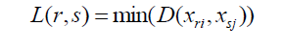
Agglomerative Clustering Single Linkage
Single Linkage: individual observations are joined based on the shortest pairwise dissimilarities (=grater similarities).
Good to find gradients.
Bad to see partitions.
Related to Minimum Spanning Tree: the shortest route that joins all points together.
Distance between two clusters is defined as the shortest distance between two points in each cluster.

Slide 25
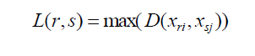
Agglomerative Clustering Complete Linkage
Complete Linkage: individual observations are joined based on the dissimilarity between the furthest object in a group
Makes compact clusters by minimising the diameter of groups, or the longest possible distance within a cluster.
Groups do not grow heterogeneous, but remain small and compact.
Distance between two clusters is defined as longest distance between two points in each cluster.

Slide 26
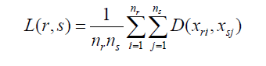
Agglomerative Clustering Average Linkage
Average Linkage is a compromise between the simple and complete linkage approaches.
There are four methods differing on how the position between groups is defined.
UPGMA [best known] → joining is at the mean of the dissimilarities to all members of the group.
Distance between two clusters is defined as the average distance between each point in one cluster to every point in the other cluster Or the position of the centroids

Slide 27
Agglomerative Clustering Average Linkage
Here, “Weights” mean if the number of object in the group are consider on the “Averaging”

Slide 28
Agglomerative Clustering Average Linkage
Avg distance between observations
Avg distance between centroids
Are these two different?
Are these two different?

Slide 29
So far so good?
Any questions?
Ready to move on?

Slide 30
Ward’s hierarchical clustering
The guiding principle
This method is based on the linear model criterion of least squares. [relates them to the linear model]
The guiding principle is to minimize the within-cluster sum of squared errors. → minimising the within group variability.
It leads to compact “spherical” clusters
Vs.

Slide 31
Ward’s hierarchical clustering
The how to in R
As other approaches before we use the hclust() function, BUT there are two possible implementations:
hclust(dist(x)^2,method="ward.D")
Dissimilarities are on a scale of squared distances.
they need to be squared before analyses.
hclust(dist(x),method="ward.D2")
Dissimilarities are on a scale of distances (distances are NOT squared).
Implemented also in the agnes() method in the cluster package.

Slide 32
Ward’s hierarchical clustering
Hclus.ward1 <- hclust((Dist.1)^2, method="ward.D")
plot(Hclus.ward1,
ylim=c(-1,6),
main="normalized-euclidean\nWard.D",
cex.main=2, cex=1.2,cex.axis=1.2,cex.lab=1.5)
Hclus.ward2 <- hclust(Dist.1, method="ward.D2")
plot(Hclus.ward2,
ylim=c(-1,6),
main="normalized-euclidean\nWard.D",
cex.main=2, cex=1.2,cex.axis=1.2,cex.lab=1.5)

Slide 33
Ward’s hierarchical clustering
hclust(dist(x)^2,method="ward.D")
Dissimilarities are transformed to a scale of squared distances.
hclust(dist(x),method="ward.D2")
Dissimilarities are on a scale of distances (distances are NOT squared)

Slide 34
Probabilistic clustering
Goal:
Consider (natural) variation and assess the uncertainty of a classification.
How to?
Bootstrap resampling
randomly sampling subsets of the data and computing the clustering on these subsets.
The pvclust package provides functions to plot a dendrogram with bootstrap p-values associated to each cluster.
approximately unbiased p-value
bootstrap probability
High values mean high support by the data

Slide 35
Probabilistic clustering
require(vegan)
data(varespec) # Vegetation and environment in lichen pastures
SppNorm <- decostand(varespec, "norm")
require(pvclust)
spech.pv <- pvclust(t(SppNorm),
method.hclust = "ward.D2",
method.dist = "euc",
parallel=TRUE)
# Plot dendrogram with p-values
plot(spech.pv)
approximately unbiased p-value
bootstrap probability
High values mean high support by the data

Slide 36
So far so good?
Any questions?
Ready to move on?

Slide 37
Hierarchic Clustering Trees and Distances
The goal of any tree is that it represents the original dissimilarity matrix.
How to test this?
Assess the relation between original dissimilarities and cophenetic distances.
Pearson’s r correlation → cophenetic correlation [should be large].
Gower distance → cophenetic distance [should be small].
The cophenetic correlation and Gower distance criteria do not always designate the same clustering result as the best.
# Cophenetic correlation
Veg.Dist <- vegdist(dune)
cl <- hclust(Veg.Dist, "average")
CophDist <- cophenetic(cl)
cor(Veg.Dist, CophDist)
# Gower (1983) DISTANCE
Veg.Dist <- vegdist(dune)
cl <- hclust(Veg.Dist, "average")
CophDist <- cophenetic(cl)
sum((spe.ch - spe.ch.UPGMA.coph)^2)

Slide 38
Hierarchic Clustering Trees and Distances
The goal of any tree is that it represents the original dissimilarity matrix.
How to test this?
Assess the relation between original dissimilarities and cophenetic distances.
Pearson’s r correlation → cophenetic correlation [should be large].
Gower distance → cophenetic distance [should be small].
The cophenetic correlation and Gower distance criteria do not always designate the same clustering result as the best.

Slide 39
Hierarchic Clustering Trees and Distances
Trees dissimilarities measured in R using the cophenetic methods from the stats package
The height of the common root for two observations is their distance in a tree

Slide 40
Hierarchic Clustering Trees and Distances
Veg.Dist <- vegdist(dune)
cl <- hclust(Veg.Dist, "average")
CophDist <- cophenetic(cl)
# Shepard-like diagrams
plot(x = Veg.Dist, y = CophDist,
xlab = "Euclidean distance",
ylab = "Cophenetic distance",
pch = 19,
main = c("UPGMA",
paste("Cophenetic correlation =",
round(
cor(Veg.Dist, CophDist), 3)
)))
abline(0, 1,lwd=2)
lines(lowess(spe.ch, spe.ch.UPGMA.coph),
col = "red",
lwd=1.5)

Slide 41
Hierarchic Clustering Trees and Distances
Assess the relation between original dissimilarities and Tree based dissimilarities
Tree based dissimilarities
original dissimilarities

Slide 42
So far so good?
Any questions?
Ready to move on?

Slide 43
Hierarchic Clustering From a tree to n-classes
The goal:
Look for interpretable clusters.
How to?
This means that a decision must be made: at what level should the dendrogram be cut?
Two criteria are possible
Single cutting level for a whole dendrogram → 70%.
Predefined a common number of groups → k-values!
All observations are combined in a tree, but you can extract 1 … n classes

Slide 44
Hierarchic Clustering From a tree to n-classes
A singe dissimilarity level
A defined number of clusters

Slide 45
Hierarchic Clustering From a tree to n-classes
A singe dissimilarity level
A define number of clusters
data(dune)# a dataset from vegan
cl <- hclust(vegdist(dune), "average")
plot(cl,cex.main=2)
# Plot cluster and add groups
plot(cl)
# You predefine the cut-off dissimilarity
abline(h = 0.7)
data(dune)# a dataset from vegan
cl <- hclust(vegdist(dune), "average")
plot(cl,cex.main=2)
# Plot cluster and add groups
plot(cl)
# You predefine the number of group you want
rect.hclust(cl, 4)

Slide 46
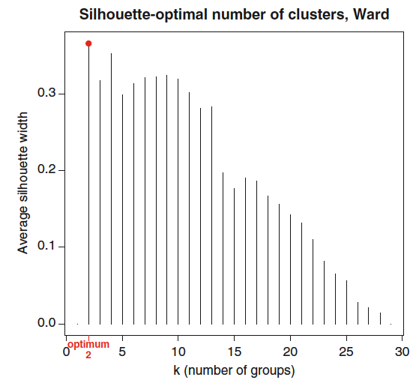
How manly Clusters?
Approach 1:
Fusion Level Values.
Approach 2:
Silhouette Widths.
Number of groups is the one with largest average silhouette width
Cutoff defined based on the distance at which clusters start to increase linearly

Slide 47
How manly Clusters? Fusion Level Values.
Graph of the Fusion Level Values.
The fusion level values = the dissimilarity where a fusion between two branches occurs.
Plotting the fusion level values may help define cutting levels.
Cutoff defined based on the distance at which clusters start to increase linearly

Slide 48
How manly Clusters? Fusion Level Values.
data(dune)# a dataset from vegan
DuneDist <- vegdist(dune)
cl <- hclust(DuneDist, "average")
# Plot fussion levels
plot(x=cl$height,
y=nrow(dune):2,
type = "S",
main = "Fusion levels - Bray - UPGMA",
ylab = "k (number of clusters)",
xlab = "h (node height)",
col = "grey",lwd=2)
# Plot number of Clusters
text(x = cl$height,
y = nrow(dune):2,
labels = nrow(dune):2,
col = "red",
cex = 2)
Cutoff defined based on the distance at which clusters start to increase linearly

Slide 49
How manly Clusters? Silhouettes Widths
Graphs of Silhouette Widths.
Silhouette width is a measure of the degree of membership of an object.
How similar an object is to its own cluster (cohesion) compared to other clusters (separation).
High Silhouette Widths == good match
Four clusters is also very good
Number of groups is the one with largest average silhouette width

Slide 50
How manly Clusters? Silhouettes Widths
# Slide - How manly Clusters? - Silhouettes Widths
DuneDist <- vegdist(dune)
cl <- hclust(DuneDist, "average")
Si <- numeric(nrow(dune))
# Define the silhouette width for each cutoff level
for (k in 2:(nrow(dune) - 1)){
sil <- silhouette(cutree(cl, k = k), DuneDist)
Si[k] <- summary(sil)$avg.width}
# Define the best cutoff level
k.best <- which.max(Si)
# plot the silhouette vs cutoff level
plot(x = 1:nrow(dune), y = Si,
type = "h",
main = "Silhouette-optimal number of clusters",
xlab = "k (number of clusters)",
ylab = "Average silhouette width")
# Highlight the optimum
axis(1, k.best,
paste("optimum", k.best, sep = "\n"),
col = "red", font = 2, col.axis = "red")
points(x = k.best, y = max(Si),
pch = 16, col = "red", cex = 1.5)
Four clusters is also very good
Number of groups is the one with largest average silhouette width

Slide 51
How manly Clusters? Silhouettes Widths
Negative values point to wrong classifications
par(mfrow=c(1,4))
for (i in 2:5){
si3 <- silhouette(cutree(cl, k = i),
DuneDist)
plot(x= si3,
nmax = 80, cex.names = 0.5, main=NA)}

Slide 52
How manly Clusters? Silhouettes Widths
Negative values point to wrong classifications

Slide 53
So far so good?
Any questions?
Ready to move on?

Slide 54
Non-hierarchical classification Partitioning of Data
Non-hierarchical partitioning classifies data into PREDEFINED number of groups, by identifying high-density regions in the data

Slide 55
Non-hierarchical classification Partitioning of Data
The Principles of Non-hierarchical classification
Operate in Euclidean space:
This means variables need to be in the same units so that the clusters are meaningful.
The process is partitional in nature:
Breaking the dataset up into a predefined number of groups.
Goal is minimize the distance on object and the cluster centre.
How you define this carter determine the two possible approaches

Slide 56

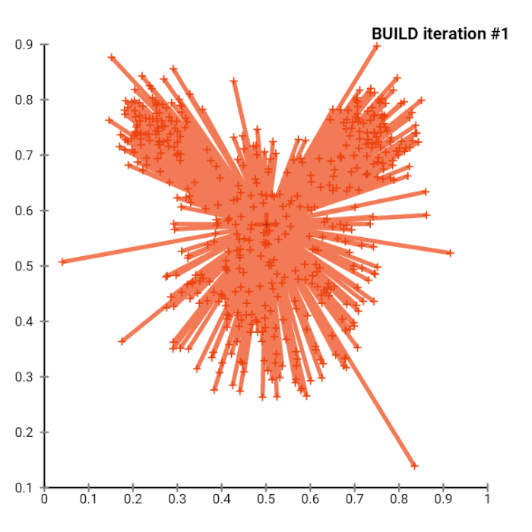
Non-hierarchical classification Partitioning of Data
k-means Clustering
k-medoids Clustering

Slide 57
Non-hierarchical classification K-means Clustering
Goal:
minimize the distance on object and the cluster centre/mean.
Step 1
Step 2
Step 3
Step 4…
K initial "means" are randomly generated within the data domain
K initial "means" are randomly generated within the data domain
The centroid of each of the k clusters becomes the new mean.
Steps 2 and 3 are repeated until convergence has been reached.

Slide 58
Non-hierarchical classification K-means Clustering
K-means R implementation
km <- kmeans(sqrt(mite),
centers = 4,
iter.max = 10)
## Contrast K-means to a cluster
miteDist <- vegdist(sqrt(mite))
cl <- hclust(miteDist,
method = "ward.D2")
plot(cl,
label = fitted(km, "classes"),
main = c("Bray-Sqrt_Ward"))
rect.hclust(cl, 4)

Slide 59
Non-hierarchical classification k-medoids Clustering
Goal:
minimize the distance on object and a cluster k-medoid.
Step 1
Step 2
Step 3
Step 4…
K initial ”medoid" are randomly generated within the data domain
K initial ”groups" are randomly generated within the data domain
The center of each of the k clusters is moved to another medoid.
Steps 2 and 3 are repeated until convergence has been reached.
medoid = objects of a data set

Slide 60
Non-hierarchical classification k-medoids Clustering
K-mediods R implementation
miteDist <- vegdist(sqrt(mite))
k.pam <- pam(miteDist,
k = 4,
diss = TRUE)
## Contrast K-mediods to a cluster
cl <- hclust(miteDist,
method = "ward.D2")
plot(cl,
label = with(k.pam, clustering),
main = c("Bray-Sqrt_Ward"),
cex=1,cex.main=2,xpd=NA)
rect.hclust(cl, 4)

Slide 61
So far so good?
Any questions?
Ready to move on?

Slide 62
Non-hierarchical classification Fuzzy Clustering
The Basis.
Sometimes cluster limits may not be so clear-cut as one would like them to be.
The goal.
Measure an object degree of memberships to the various clusters.
The how to.
One simple approach is the the estimation of c-means.
There are many functions and packages here we focus on the function fanny() of the cluster() package.
But as k-means and k-medoids → you specify how may groups before hand.

Slide 63
Non-hierarchical classification Fuzzy Clustering
> require(vegan)
> data(mite)
> d <- vegdist(sqrt(mite))
> require(cluster)
> fc <- fanny(d, k=4, memb.exp=sqrt(2)) # cluster package
> head(fc$membership)## Probability of membership
[,1] [,2] [,3] [,4]
1 0.3918715 0.3618036 0.12316244 0.12316244
2 0.3705927 0.3798975 0.12475491 0.12475491
3 0.3864998 0.3978146 0.10784280 0.10784280
4 0.3754518 0.4383848 0.09308171 0.09308171
...
> head(fc$clustering) ## Highest probability cluster
1 2 3 4 5 6
1 2 2 2 2 2

Slide 64
Non-hierarchical classification Fuzzy Clustering
The size of the section represent the “degree of memberships “ to on of the preestablished 4 groups

Slide 65
So far so good?
Any questions?
Ready to finish?

Slide 66
In summary…
Classification provides an approach to simplify multivariate data description.
Classification is about defining discrete groups of objects.
Grouping is based on the (di)similarity between objects
Once you have a (di)similarity matrix you can build a Hierarchic or Non-hierarchic groping that shows the (di)similarity of the evaluated objects.
Trees have no order and similarity between objects points can only interpreted through their common root
Non-hierarchic approaches are Euclidean in nature!!!

